Slide 1

Capstone Project Presentation
Customer Behaviour & Sales Forecasting
Group Members
Abhishek
Anitha
Meriam
Nijo

Slide 2

Executive Summary
The challenge - Data scattered across multiple sources causing inefficient decisions
The Solution
Unified Data Pipeline
Data Driven Analytics
Realtime Dashboards
Prediction & Forecasting
The Business Impact
Inventory Optimization
Demand Accuracy
Customer Targeting
ROI – Cost Savings & Revenue Growth

Slide 3
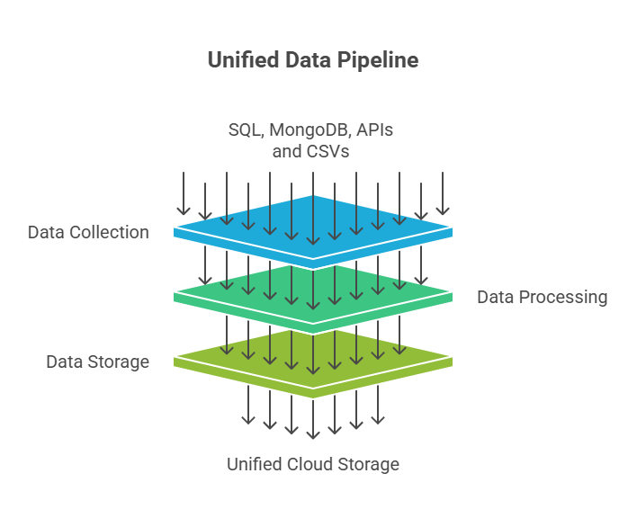
Data Pipeline Visualisation

Slide 4
Customer & Sales Analysis
Key Metrics
Average Transaction Value: $632.13
Active Customer Base: 3K
Customer Lifetime Value: $5,349.95
RFM Analysis Results
Product Analysis
Segement | Count of customers | Total Revenue
Churn-Risk | 6 | 7,395
High-Value | 646 | 8,429,361
One-Time | 6 | 2,187
Others | 2342 | 10,422,787
646 customers (21.5%) generate $8.4M (35% of revenue)
Outreach and retention offers for churn-risk & one-time
Convert ‘Others’ to high-value
Books are major revenue driver
Top selling product - 451 (Home & Kitchen) with highest value per unit ($446)
Promote beauty & electronics for high-value transactions

Slide 5
Customer & Sales Analysis
Sales Trend Analysis
Insights:
12% year-over-year increase
Books and Electronics show year-round demand
Sunday lowest at 10% of weekly sales
US & UK leading sales
20 products with zero sales in last 90 days
Recommendations:
Expand to Germany
Optimise India, US and UK
Focus on high-value fast moving products

Slide 6
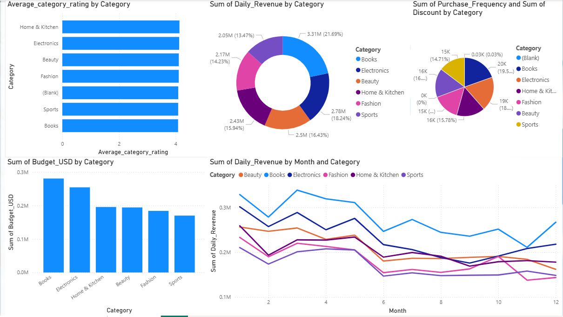
Dashboard Solutions
Benefits:
Overall KPIs
Revenue Trends
Forecast summary
Regular data refresh
Real-time monitoring of important metrics

Slide 7
Sales Prediction & Forecasting
Key Metrics:
30K Transactions analysed
500 Products across 6 categories
3+ Years of historical data
Demand Forecasting Results
Customer Purchase Probability
Model | MAE | R2_Score
Linear Regression | 336.53 | 0.181
Random Forest | 335.40 | 0.190
Model
Analysis
Model | Accuracy | Precision
Logistic Regression | 0.968 | 0.9259
Random Forest | 0.998 | 1
Top Predictors:
Revenue Moving Average – 25.8%
Promotion Intensity – 14%
Revenue Yesterday – 13%
Top Predictors:
Days Since Last Purchase – 73%
Customer Lifetime Days – 12%
Average Order Value – 8%
Inventory Optimization
Category | Current Stock | Predicted Demand | Risk Level | Recommended Action | Suggested Order Quantity | Days of Stock
Beauty | 9485 | 11926 | Normal | Monitor | 0 | 23.9
Books | 2365 | 7680 | Medium Risk | Plan reorder soon | 579 | 9.2

Slide 8
Key Deliverables & Next Steps
Delivered:
Scalable data pipeline
Customer Intelligence
Predictive Power
Real-time Power BI dashboards
Recommendations:
Deploy forecasting model for top 20% product categories
Expand customer segmentation to personalized marketing campaigns
Real-time inventory alerts implementation

